Slide 1
Yii PHP Framework
Lecturer: Ngo Huy Bien
Software Engineering Department
Faculty of Information Technology
VNUHCM - University of Science
Ho Chi Minh City, Vietnam
nhbien@fit.hcmus.edu.vn

Slide 2

Objectives

Slide 3

References
Web Application Development with Yii and PHP
Qiang Xue et al. The Definitive Guide to Yii 2.0. 2014.

Slide 4
What is Yii [1]
The name Yii is an acronym for Yes, it is, and is pronounced as Yee or (ji:).
Yii is a high-performance, component-based, web application framework written in PHP5.
Yii is packed with features to help you meet those high demands placed on today's web applications.
AJAX-enabled widgets,
RESTful and SOAP Web services integration,
enforcement of an MVC architecture,
DAO and relational ActiveRecord database layer,
sophisticated caching,
hierarchical role-based access control,
theming, internationalization (I18N), and localization (L10N)

Slide 5
Why Yii?
Easy
You only need to know PHP and object-oriented programming.
Efficient
You can get your application up and running with little or no manual configuration.
All Yii applications are built using the Model-View-Controller (MVC) architecture.
This minimizes duplication and helps promote code reuse and ease of maintainability.
It is remarkably fast and performance optimized. (?)
Extensible
A primary activity when developing a Yii application is extending the core framework classes.

Slide 6
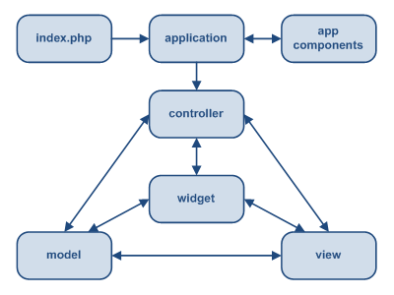
Static Structure of Yii Application [2]
Yii implements the model-view-controller (MVC) design pattern.
In MVC, the model represents the information (the data) and the business rules; the view contains elements of the user interface such as text, form inputs; and the controller manages the communication between the model and the view.
Yii also introduces a front-controller, called Application, which encapsulates the execution context for the processing of a request.
Application collects some information about a user request and then dispatches it to an appropriate controller for further handling.

Slide 7
Model [1]
Yii implements two kinds of models, namely
the form model (a CFormModel class) and
active record (a CActiveRecord class).
They both extend from the same base class CModel.
The class CFormModel represents a data model that collects HTML form inputs.
It encapsulates all the logic for form field validation, and any other business logic that may need to be applied to the form field data.
It can then store this data in memory or, with the help of an active record model, store data in a database.
Each AR object in Yii is an instance of CActiveRecord or its child class, which wraps a single row in a database table or view, that
encapsulates all the logic and details around database access, and
houses much of the business logic that is required to be applied to that data.

Slide 8
View
Typically the view is responsible for rendering the user interface, often based on the data in the model.
A view in Yii is a PHP script that contains user interface-related elements, often built using HTML, but can also contain PHP statements.
Usually, any PHP statements within the view are very simple, conditional or looping statements, or refer to other Yii UI-related elements such as HTML helper class methods or prebuilt widgets.

Slide 9
Controller
The controller is our main director of a routed request, and is responsible for taking user input, interacting with the model, and instructing the view to update and display appropriately.
A controller in Yii is an instance of CController or a child class thereof.
When a controller runs, it performs the requested action, which then interacts with the necessary models, and renders an appropriate view.
An action, in its simplest form, is a controller class method whose name starts with the word action.

Slide 10
Installing Yii
XAMPP Apache + MySQL + PHP + Perl
https://www.apachefriends.org/index.html
Yii
http://www.yiiframework.com/download/
http://localhost/yii/requirements/index.php

Slide 11
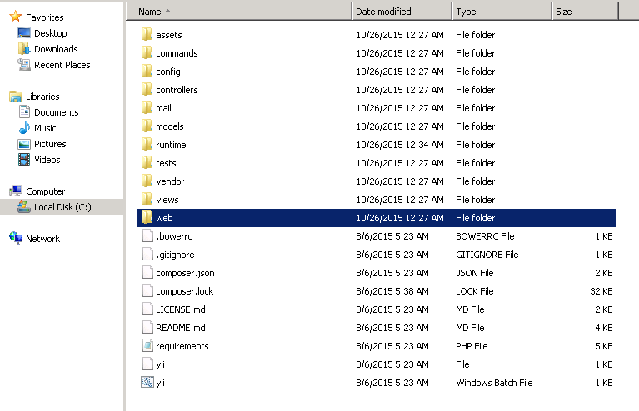
Physical Structure [2]

Slide 12
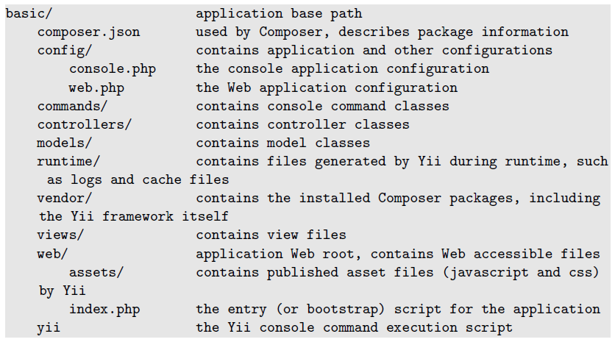
Application Structure

Slide 13
Creating a New Application
./framework/yiic webapp helloworld
The yiic webapp command is used to create a brand new Yii web application.

Slide 14
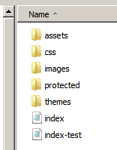
New Application Structure
index.php: Web application entry script file
index-test.php: Entry script file for loading a test configuration
assets/: Contains published resource files
css/: Contains CSS files
images/: Contains image files
themes/: Contains application themes
protected/: Contains protected (non-public) application files

Slide 15
(Optionally) Modifying index.php
require_once($yii); $app = Yii::createWebApplication($config); // we need to set this to UTC, regardless of default timezone // which is only for display. UTC is what timestamps etc. are using. Yii::app()->setTimeZone("UTC"); $app->run();

Slide 16
Configuring Gii
protected/config/main.php
http://localhost/helloworld/index.php?r=gii
'modules'=>array(
// uncomment the following to enable the Gii tool
/*
'gii'=>array(
'class'=>'system.gii.GiiModule',
'password'=>'Enter Your Password Here',
// If removed, Gii defaults to localhost only.
Edit carefully to taste.
'ipFilters'=>array('127.0.0.1','::1'),
),
*/
),

Slide 17
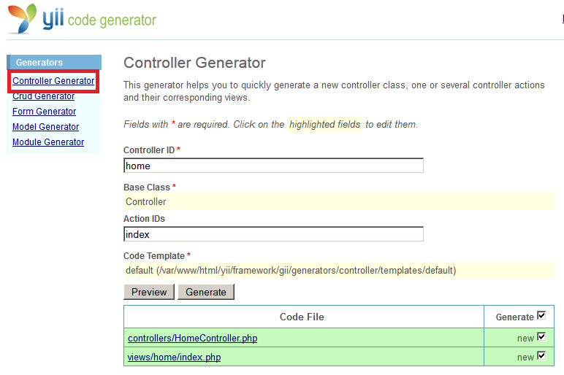
Creating the Controller

Slide 18
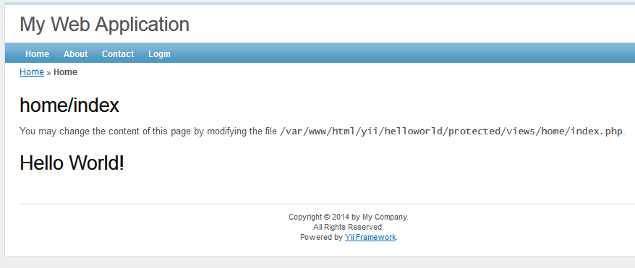
Modifying the View

Slide 19


Slide 20
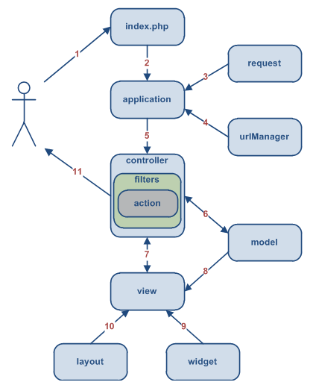
A Typical Workflow (1 - 3) [2]
A user makes a request with the URL http://www.example.com/index.php?r=post/show&id=1 and the Web server handles the request by executing the bootstrap script index.php.
The bootstrap script creates an Application instance and runs it.
The Application obtains detailed user request information from an application component named request.

Slide 21
index.php and yii.php
<?php
// change the following paths if necessary
$yii=dirname(__FILE__).'/../framework/yii.php';
$config=dirname(__FILE__).'/protected/config/main.php';
$app = Yii::createWebApplication($config);
$app->run();
require(dirname(__FILE__).'/YiiBase.php');
//Yii is a helper class serving common framework functionalities.
class Yii extends YiiBase{}

Slide 22
YiiBase.php
//YiiBase is a helper class serving common framework functionalities.
class YiiBase{
public static function createWebApplication($config=null)
{
return self::createApplication(‘CWebApplication’, $config);
}
public static function createApplication($class, $config=null)
{
return new $class($config);
}
...

Slide 23
A Typical Workflow (4) [2]
The application determines the requested controller and action with the help of an application component named urlManager.
For this example, the controller is post, which refers to the PostController class; and the action is show, whose actual meaning is determined by the controller.

Slide 24
A Typical Workflow (5) [2]
The application creates an instance of the requested controller to further handle the user request.
The controller determines that the action show refers to a method named actionShow in the controller class.
It then creates and executes filters (e.g. access control, benchmarking) associated with this action.
The action is executed if it is allowed by the filters.

Slide 25
CWebApplication.php
// CWebApplication extends CApplication by providing
// functionalities specific to Web requests.
class CWebApplication extends CApplication
{
// It first resolves the request into controller and action,
// and then creates the controller to perform the action.
public function processRequest()
{
$route=$this->getUrlManager()->parseUrl(
$this->getRequest());
$ca=$this->createController($route);
list($controller, $actionID)=$ca;
$controller->init();
$controller->run($actionID);
...
}
}

Slide 26
CApplication.php
// An application serves as the global context // that the user request is being processed.
// It manages a set of application components
// that provide specific functionalities to the
// whole application.
abstract class CApplication extends CModule
{
abstract public function processRequest();
public function run()
{
$this->processRequest();
}
}

Slide 27
createController method
class CWebApplication extends CApplication
{
// The route should contain the controller ID
// and the action ID.
// It may also contain additional GET variables.
// * If the first segment is found in controller map
// the corresponding controller configuration will be used
// to create the controller;
// * If the first segment is found to be a module ID,
// the corresponding module will be used
// to create the controller;
// * Otherwise, it will search under the controller path
// to create the corresponding controller.
public function createController($route, $owner=null)
{
}
}

Slide 28
CController.php
// CController manages a set of actions which deal with the // corresponding user requests.
// Through the actions, CController coordinates the data
// flow between models and views.
class CController extends CBaseController
{
public function run($actionID) ()
{
...
// Use reflection to invoke an action method
$action->runWithParams($this->getActionParams())
...
}
}

Slide 29
A Typical Workflow (6 - 11) [2]
The action reads a Post model whose ID is 1 from the database.
The action renders a view named show with the Post model.
The view reads and displays the attributes of the Post model.
The view executes some widgets.
The view rendering result is embedded in a layout.
The action completes the view rendering and displays the result to the user.

Slide 30
HomeController.php
class Controller extends CController
{
public $layout='//layouts/column1';
}
class HomeController extends Controller
{
public function actionIndex()
{
...
$this->render('index');
...
}
}

Slide 31
CController.php: render
// This method first calls renderPartial to render the view (called content view).
It then renders the layout view which may embed the content view at appropriate place.
class CController extends CBaseController
{
public function render($view, $data=null,
$return=false) ()
{
$output=$this->renderPartial($view, $data, true);
$output=$this->renderFile($layoutFile,
array('content'=>$output), true);
$output=$this->processOutput($output);
return $output;
}
}

Slide 32
//layouts/column1
<?php /* @var $this Controller */ ?>
<?php $this->beginContent('//layouts/main'); ?>
<div id="content">
<?php echo $content; ?>
</div>
<!-- content -->
<?php $this->endContent(); ?>

Slide 33
//layouts/main
<?php /* @var $this Controller */ ?>
<!DOCTYPE html PUBLIC "-//W3C//DTD XHTML 1.0 Transitional//EN" "http://www.w3.org/TR/xhtml1/DTD/xhtml1-transitional.dtd">
<html xmlns="http://www.w3.org/1999/xhtml" xml:lang="en" lang="en">
<head>
...
<body>
<div class="container" id="page">
<div id="header"><div id="logo">
<?php echo CHtml::encode(Yii::app()->name); ?>
</div></div>
<!-- header -->
...
<?php echo $content; ?>
...

Slide 35
Widget
A Yii widget is an instance of the CWidget class (or a child class thereof), and is a presentational component typically embedded in a view file to display self-contained, reusable user interface features.
We'll add our new widget to the protected/components/ directory, as the contents of this directory are already specified in the main configuration file to be auto-loaded within the application.
View files for widgets, by convention, are placed in a protected/components/views/ directory within the same directory where the widget resides and are named the same as the widget, except starting with a lowercase letter.

Slide 36
Creating a Widget
// protected/components/TestWidget.php
<?php
class TestWidget extends CWidget
{
public function init() {}
public function getData() { return "I AM A WIDGET"; }
public function run()
{
// this method is called by CController::endWidget()
$this->render('TestWidget');
}
}

Slide 37
Creating a Widget View
// protected/components/views/TestWidget.php
This is a data from the test widget.<br />
<?php echo $this->getData() ?>
// protected/views/site/index.php (widget container)
<h1>Calling a widget</h1>
<?php $this->widget('TestWidget'); ?>

Slide 39
Modules
A module in Yii is very much like an entire mini-application contained within a larger application.
It has a very similar structure, containing models, views, controllers, and other supporting components.
However, modules cannot be deployed themselves as standalone applications; they must reside within an application.
Large applications can often be segmented into discrete application features that could be built separately using modules.

Slide 40
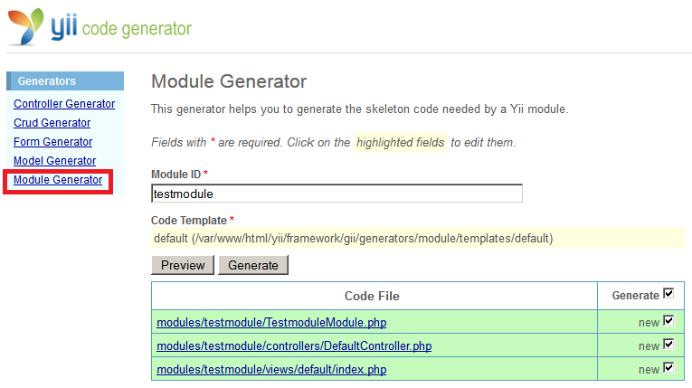
Creating a Module

Slide 41
Configuring a Module
protected/config/main.php
'modules'=>array(
'gii'=>array(
'class'=>'system.gii.GiiModule',
'password'=>'Enter Your Password Here',
// If removed, Gii defaults to localhost only.
Edit carefully to taste.
'ipFilters'=>array('127.0.0.1','::1'),
),
'testmodule',
),

Slide 42
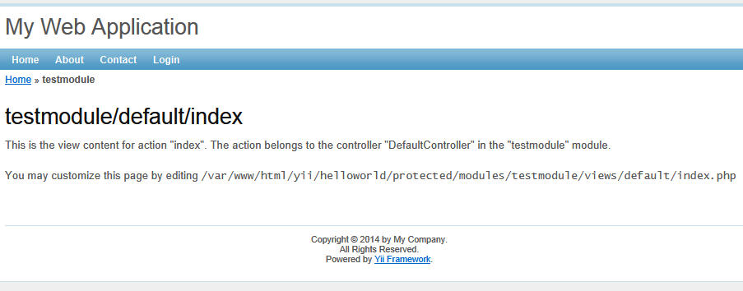
Module Output
http://localhost/helloworld/index.php?r=testmodule

Slide 44
Layouts
A layout in Yii is a special view file used to decorate other view files.
Layouts typically contain markup or other user interface components that are common across multiple view files.
When using a layout to render a view file, Yii embeds the view file into the layout.

Slide 45
Specifying a Layout
There are two main places where a layout can be specified.
One is the property called $layout of the CWebApplication itself. This defaults to protected/views/layouts/main.php. As is the case with all application settings, this can be overridden in the main configuration file protected/config/main.php.
The other place to specify the layout is by setting the $layout property of the controller class. Using the yiic tool to create our initial application automatically created a controller base class Webroot/protected/components/Controller.php, from which all of our other controller classes extend. Opening up this file reveals that the $layout property has been set to column1.
return array(
...
'layout'=>'newlayout',

Slide 46
Applying and Using a Layout
The use of a layout file is implicit in the call to the CController::render() method.
That is, when you make the call to the render() method to render a view file, Yii will embed the contents of the view file into the layout file specified in either the controller class or the one specified at the application level.
When the render() method is called, what happens behind the scenes is that a call is first sent to renderPartial() on the specified view file.
The output of this is stored in a variable called $content, which is then made available to the layout file.

Slide 47
Applying a New Layout
Create a new file called newlayout.php and place it in the default directory for layout files, called /protected/views/layouts/.
Open up SiteController.php and override the layout property set in the base class by explicitly adding it to this class, as such:
class SiteController extends Controller
{
public $layout='newlayout';

Slide 48
Nesting the Layouts
Not only can normal view files be decorated by layout files, but layout files themselves can be decorated by other layout files forming a hierarchy of nested layout files.
The column1.php layout file is itself decorated by the main.php layout file.
The view being specified here is our main layout page '//layouts/main'.
Whatever content is between the calls beginContent() and endContent() will be decorated with the view specified in the call beginContent().
<?php $this->beginContent('//layouts/main'); ?>
<div id="content">
<?php echo $content; ?>
</div><!-- content -->
<?php $this->endContent(); ?>

Slide 49
Rendering a View
// SiteController::actionLogin() method
$this->render('login');
Render all of the content in the specific view file /protected/views/site/login.php, and make that content available via the variable $content to the layout file specified in the controller, which in this case is column1.php.
Since column1.php is itself being decorated by the layout main.php, the content between the beginContent() and endContent() calls is again rendered and made available to the main.php file, again via the $content variable.
The layout file main.php is rendered and returned back to the user, incorporating both the content from the specific view file for the login page as well as the "nested" layout file column1.php.

Slide 51
Building Themes in Yii
Theming is a systematic way of customizing the outlook of pages in a Web application. By applying a new theme, the overall appearance of a Web application can be changed instantly and dramatically.
In Yii, each theme is represented as a directory consisting of view files, layout files, and relevant resource files, such as images, CSS files, and JavaScript files.
The name of a theme is the same as its directory name.
By default, all themes reside under the same directory WebRoot/themes.
Contents under a theme directory should be organized in the same way as those under the application base path.
So all the view files are located under a views/ directory, layout view files under views/layouts/, and system view files under views/system/.

Slide 52
Using a Theme
To activate a theme, set the theme property of the Web application to be the name of the desired theme.
This can be done either in the application configuration or during runtime in controller actions.
Yii::app()->theme

Slide 53
Creating a Theme [1] [2]
We need to name our new theme and create a directory under the Webroot/themes directory with this same name.
Then under this newly created directory, create two other new directories called css/ and views/.
Remember that the directory structure needs to mirror that in the default Webroot/protected/views/ directory
For example, if we want to replace the create view of PostController with a view in the classic theme, we should save the new view file as WebRoot/themes/classic/views/post/create.php.
When we call render or renderPartial to display a view, the corresponding view file as well as the layout file will be looked for in the currently active theme.

Slide 54
Example of Directory Organization
WebRoot/
assets
protected/
.htaccess
components/
controllers/
models/
views/
layouts/
main.php
site/
index.php
themes/
basic/
views/
.htaccess
layouts/
main.php
site/
index.php
fancy/
views/
.htaccess
layouts/
main.php
site/
index.php

Slide 55
Configuring the Application to Use a Theme
Simply add the following name=>value pair to the returned array in the /protected/config/main.php file:
The application will first look for view files in this new theme and use them if they exist, otherwise it will pull them from the default location.
'theme'=>'newtheme',

Slide 56
CMS
http://easyiicms.com/

Slide 57

Thank You for Your Time

